Slide 1
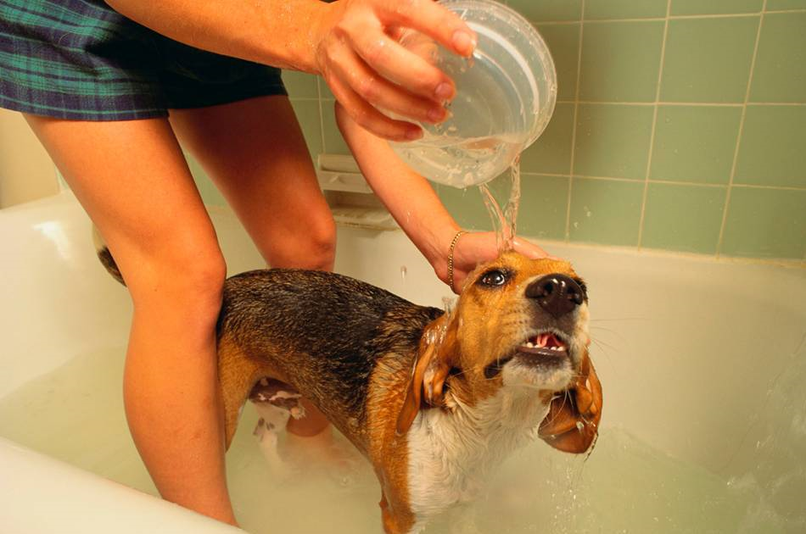
Drugs for Skin Conditions
Chapter 17

Slide 2
Basic Anatomy & Physiology
The skin is made up of three layers:
  Epidermis (the most superficial layer that contains cells, but not blood vessels)
  Dermis (the middle layer that is composed of blood and lymph vessels, nerve fibers, and the accessory organs of skin such as glands and hair follicles)
  Hypodermis (subcutaneous - the deepest layer that is composed of connective tissue)

Slide 3
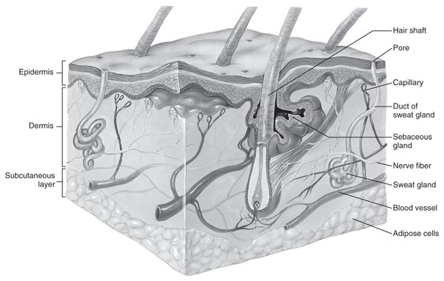
Basic Anatomy & Physiology

Slide 4
Roles of Skin
First line of defense in immunity (physical barrier)
Waterproofing the body
Preventing fluid loss
Vitamin D synthesis
Sebaceous glands lubricate skin and discourage bacterial growth on surface
Sweat glands regulate body temperature and excrete wastes through sweat
Hair controls heat loss and is a sense receptor
Nails, hooves, and claws protect the surface of the distal phalanx

Slide 5
Drugs Used in Treating Skin Disorders
Topical treatments consist of agents applied to a surface; they affect the area to which they are applied
  Topical antibiotics and antifungals are covered in Table 17-1 in your textbook
Systemic treatments consist of drugs given systemically that affect many areas of the body

Slide 6
Drugs Used in Treating Pruritus
Pruritus: itching, may be associated with many skin and systemic diseases
Topical antipruritics provide moderate relief of itching
Usually used in combination with systemic medications such as antihistamines and corticosteroids
Some products listed in other categories may have antipruritic effects, but control of itching is not their main function.

Slide 7
Nonsteroidal Topical Antipruritics
Local anesthetics inhibit the conduction of nerve impulses from sensory nerves, thereby reducing pain and pruritus.
They are generally used topically to minimize discomfort associated with allergies, insect bites, and burns.
Poorly absorbed from intact skin, but can be absorbed through damaged skin.
Examples include: lidocaine, tetracaine, benzocaine, and pramoxine

Slide 8
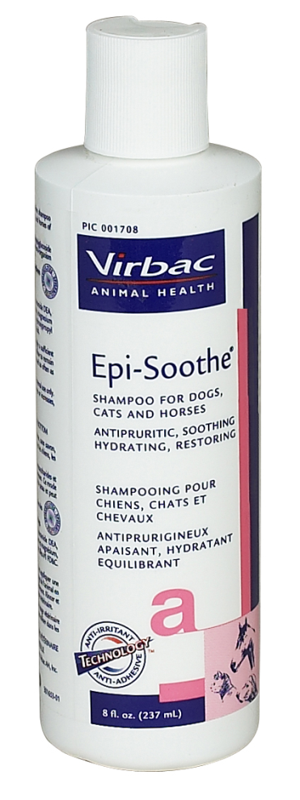
Nonsteroidal Topical Antipruritics
Soothing agents/Colloidal Oatmeal Shampoos
  Oatmeal has soothing and anti-inflammatory effects when applied topically.

Slide 9
Nonsteroidal Topical Antipruritics
Antihistamines are antipruritics that provide temporary relief of pain and itching associated with allergic reactions and sensitive skin.
Products containing diphenhydramine and oatmeal calm itching and soothe irritated skin.

Slide 10
Topical Corticosteroids
Topically applied steroids are very effective. They have anti-inflammatory, antipruritic, and vasoconstrictive action.
When applied to skin, they interfere with normal immune responses and reduce redness, itching, and edema.
They also slow the rate of skin production; hence slowing healing time of wounds.
Damaged skin at application site may increase the amount of drug absorbed into the bloodstream and result in systemic side effects.

Slide 11
Topical Corticosteroids
The least potent topical corticosteroid is hydrocortisone.
Topical steroids containing a fluorine atom are among the most potent (fluocinolone)
Classified according to duration of action (short-acting, intermediate-acting, long-acting)
Frequently combined with other ingredients such as antibiotics to broaden their action.

Slide 12
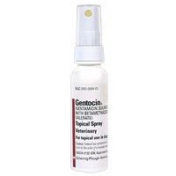
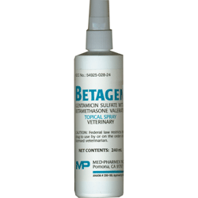
Topical Corticosteroids
Products include: Gentocin Topical Spray® (betamethasone and gentamicin), Vetalog Cream® (triamcinolone)

Slide 13
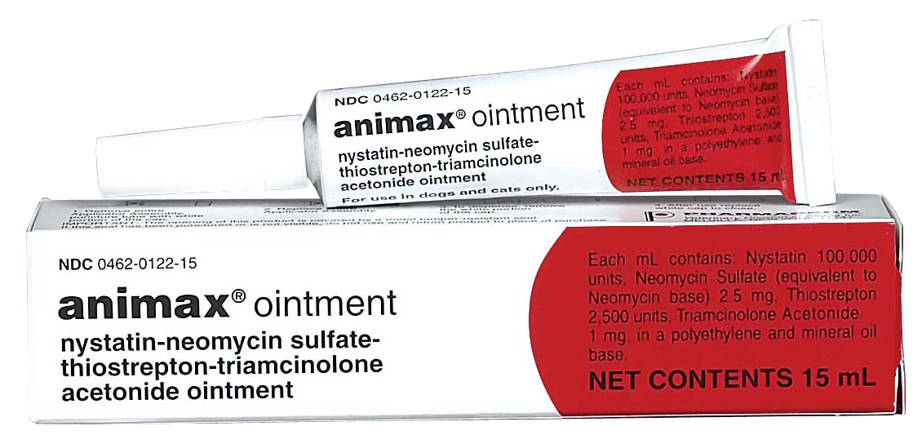
Antibiotic/Corticosteroid

Slide 14
Seborrhea
Seborrhea is characterized by abnormal flaking or scaling of the epidermis and may be accompanied by increased oil production (seborrhea oleasa) or not (seborrhea sicca)
  Accelerated skin cell turn-over with or without excessive sebum production.

Slide 15
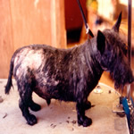
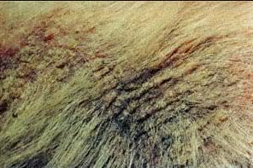
Seborrhea

Slide 16
Keratolytics
Keratolytics are an important group of antiseborrheics
  Keratolytics remove excess keratin and promote loosening of the outer layers of the epidermis
  Keratolytics break down the protein structure of the keratin layer, permitting easier removal of this material
  Found in medicated shampoos to help in treatment of seborrhea

Slide 17
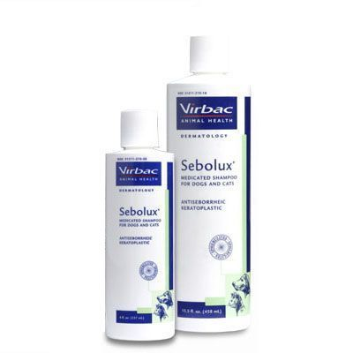
Keratolytics
Sulfur: keratolytic, antipruritic, antibacterial, antifungal, and antiparasitic.
  It is nonirritating and nonstaining
  Used to treat seborrhea sicca
  Sebolux Shampoo®
  SebaLyt Shampoo®

Slide 18
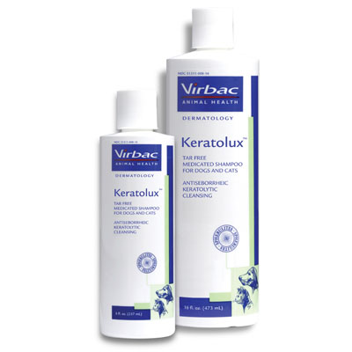
Keratolytics
Salicylic acid: keratolytic, antipruritic, and antibacterial
  Used to treat seborrhea sicca and hyperkeratotic skin disorders
  Keratolux Shampoo®
  SebaLyt Shampoo®

Slide 19
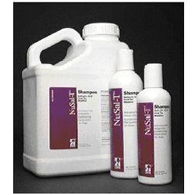
Keratolytics
Coal tar: keratolytic and degreasing
  Irritating and may stain light-colored haircoats.
  Used to treat seborrhea sicca
  May be irritating to cats
  NuSal-T®
  Mycodex Tar and Sulfur Shampoo®

Slide 20
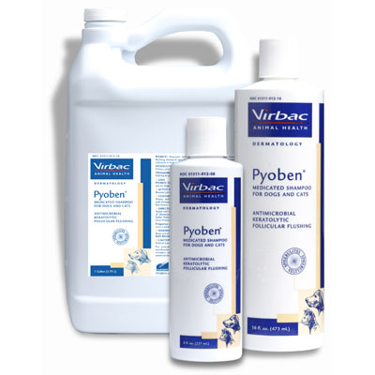
Keratolytics
Benzoyl peroxide: keratolytic, antipruritic, antibacterial, and degreasing
  Used to treat seborrhea oleosa, moist dermatitis (Hot-spots), pyoderma, stud tail, and a variety of skin lesions that are moist and/or contaminated with bacteria
  Pyoben® gel or shampoo

Slide 21
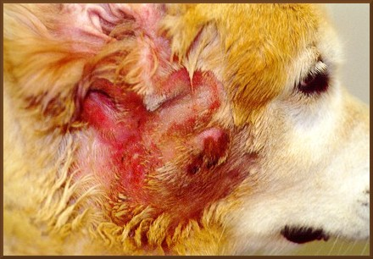
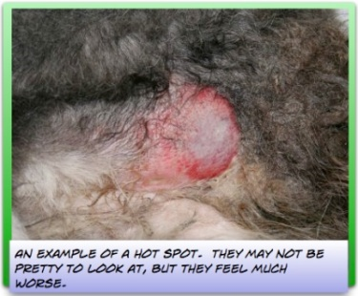
Hot Spots

Slide 22
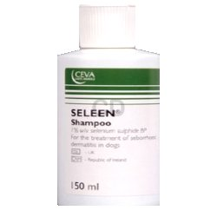
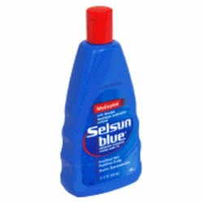
Keratolytics
  Selenium sulfide: keratolytic, degreasing, and antifungal
    Seborrhea and eczema
    May result in subsequent irritation
    Seleen Plus Medicated Shampoo®
    Selsun Blue®

Slide 23
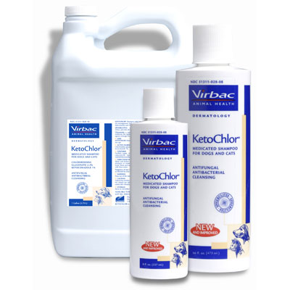
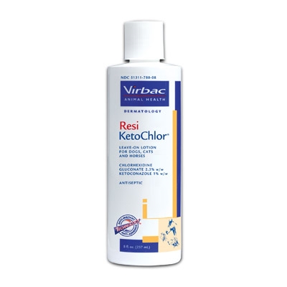
Antifungal, Antibacterial

Slide 24
Other Agents Used to Treat Skin Disorders
Astringents
Antiseptics
Soaks and Dressings
Caustics
Counterirritants
Immunomodulators
Retinoids

Slide 25
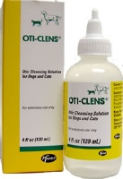
Astringents
Astringents are agents that constrict tissues.
Stop discharge by precipitating protein
Have some antibacterial properties
Used to treat moist dermatitis ; effective against Pseudomonas
Acetic acid, found in ear preparations such as Oti-Clens®

Slide 26
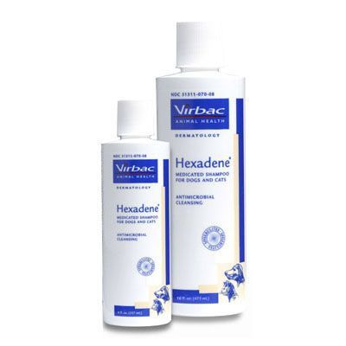
Antiseptics
Substances that kill or inhibit the growth of microorganisms on living tissue
Alcohols are bactericidal, astringent, and cooling
Benzalkonium chloride is antibacterial and antifungal
Chlorhexidine is bactericidal, fungicidal, and partially virucidal
Iodine is bactericidal, fungicidal, virucidal, and sporicidal.
Triclosan is antibacterial.

Slide 27
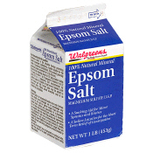
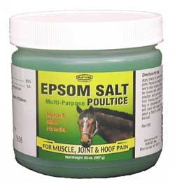
Soaks and Dressings
Substances applied to areas to draw out fluid or relieve itching
Aluminum acetate (Burrow’s solution) is drying and mildly antiseptic. It is used as a soak to relieve itching and inflammatory discharge.
Magnesium sulfate (found in Epsom salts) is used in wound dressings to draw fluid out of tissues.

Slide 28
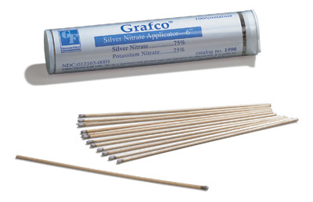
Caustics
Substances that destroy tissue
Used to treat warts and excessive granulation tissue (“proud flesh” in horses)
Include Silver Nitrate Stick Applicators® and Equine HoofPro®
  Note: Silver nitrate products will stain

Slide 29
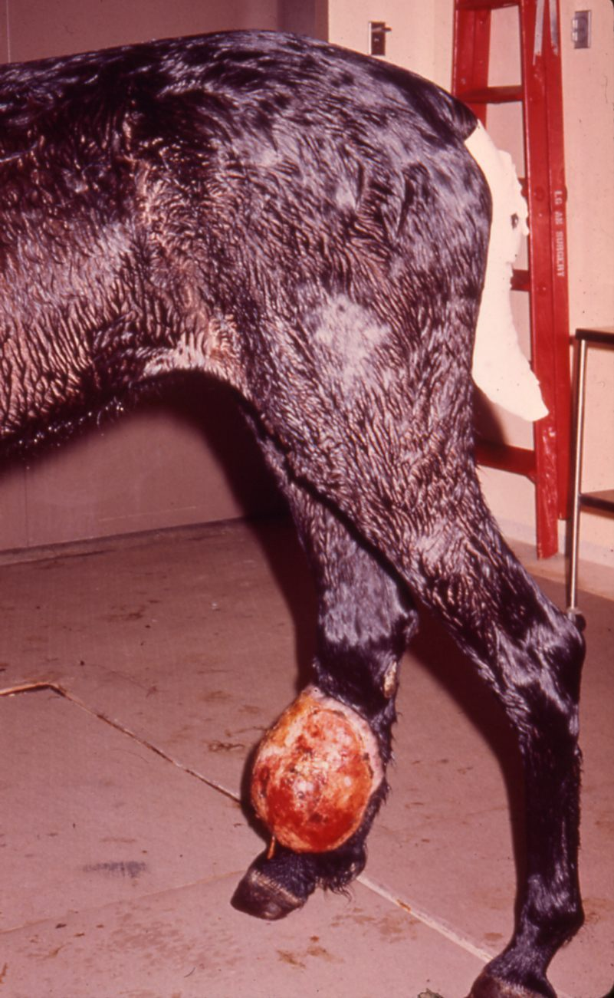
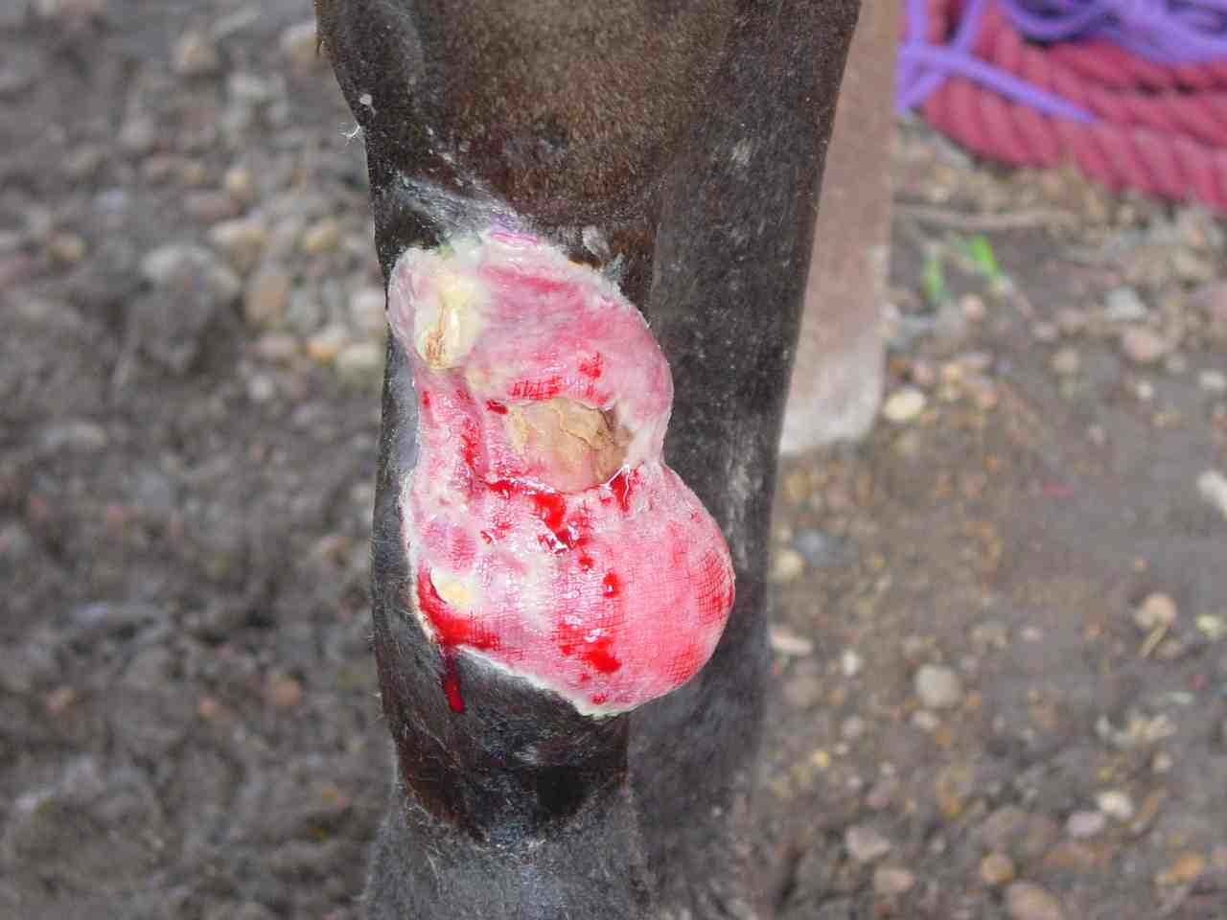
Proud Flesh

Slide 30
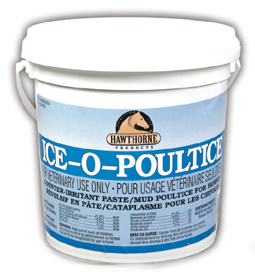
Counterirritants
Substances that produce irritation and inflammation in areas of chronic inflammation
Contain alcohol, camphor, menthol, iodine, and/or witch hazel
Thought to increase blood supply to the area, which in turn brings WBCs, antibodies, etc. to are to stimulate healing and carry away kinins to relieve pain.

Slide 31
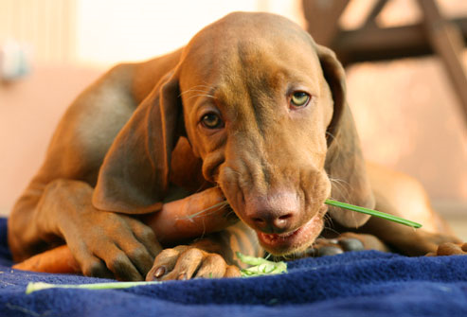
Immunomodulators
Substances that have an effect on the immune system
Either immunostimulatory or Immunosuppressive

Slide 32
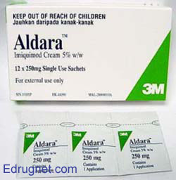
Imiquimod (Aldara®)
Stimulates patient’s monocytes and macrophages to induce regression of viral protein production
Used to treat squamous cell carcinoma, feline herpes viral dermatitis, and localized solar dermatitis.

Slide 33
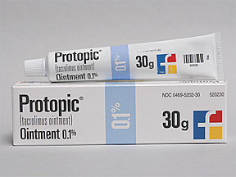
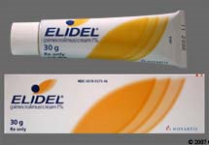
Tacrolimus (Protopic®) & Pimecrolimus (Elidel®)
Inhibits T-lymphocyte activation.
Used to treat atopic dermatitis, lupus erythematosus, pemphigus erythematosus or foliaceous and perianal fistulas

Slide 34
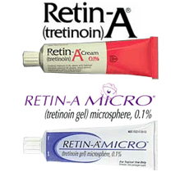
Retinoids
Stimulate cellular mitotic activity
Used to treat chin acne, callous pyoderma, and footpad hyperkeratosis

Slide 35
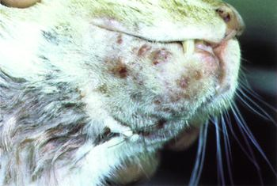
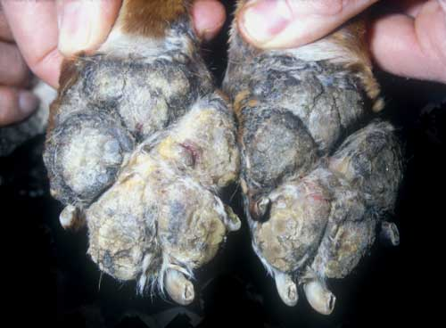
Retinoid Uses

